Slide 1
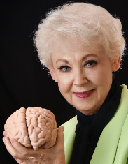

Epigenetics and
Cellular Memory
©Arlene R. Taylor PhD
www.arlenetaylor.org
www.LLM.life
5-19

Slide 2
Nature + Nurture = You
Nature involves genetics, which account for about 30 percent of the impact to your health and lifespan
Genetics is your biological heredity, the
biological “stuff” you inherit from your
mother and father⎯including your
chromosomes and 25,000 genes that
contain the “blueprints” for the building
blocks of life and the person you were meant to be
©Arlene R. Taylor PhD - www.ArleneTaylor.org

Slide 3
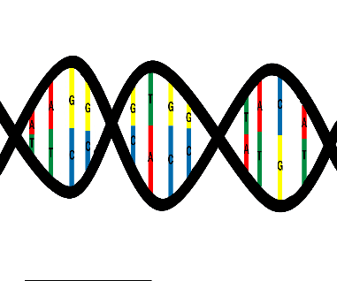
Chromosomes are twisted strands of DNA divided
into smaller bits called genes
Picture chromosomes as a type of coiled ladder with
the genes located on the ladder rungs⎯1962 Nobel
Prize was awarded for the discovery of this double helix
Genes determine your inherited traits such as male or
female, height, skin-eye-hair color, your IQ range, specific areas of giftedness (music, math, literature, science, the arts, mechanics, inventiveness, brain functions … )
©Arlene R. Taylor PhD - www.ArleneTaylor.org

Slide 4
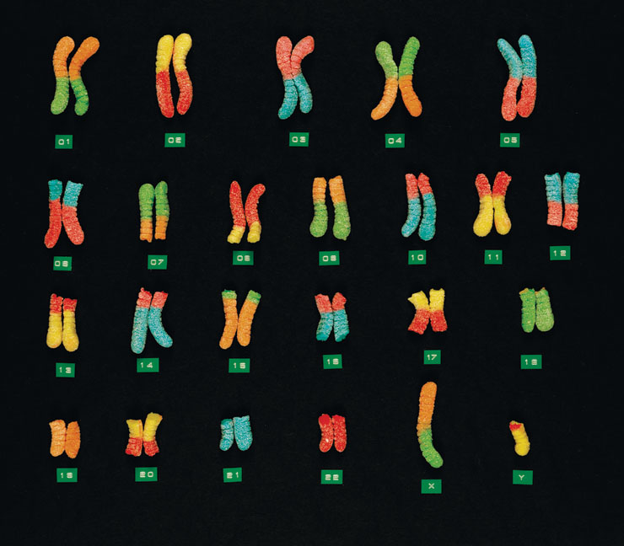
46 chromosomes: 22 pairs (one from each parents) and the 23rd pair is the X and the Y
©Arlene R. Taylor PhD - www.ArleneTaylor.org

Slide 5
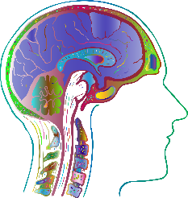
More than 95 percent of embryos form correctly, based on the genetic blueprints; the rest may exhibit a birth defect
By the end of the first 12 weeks, the initial
construction of all the body organs is in place
The brain, however, continues to develop
throughout pregnancy with neurons being created at the rate of 250,000 per minute⎯more than half of all fetal metabolic energy is devoted to growing the brain, which will continue to develop and mature until late 20’s or early 30’s
©Arlene R. Taylor PhD - www.ArleneTaylor.org

Slide 6
Nurture involves epigenetics: “epi” means “above.” Above genetics. It accounts for about 70 percent of your level of wellness and lifespan. It is everything that is not genetics:
The sum total of your internal and external environments, beginning with conception and continuing
with a calm or stressful gestation, a
pleasant or traumatic birth experience,
the memory of which likely is lodged in
your subconscious, and all the memories
created by ALL your lifestyle choices and
by events that you did not create or even want …
©Arlene R. Taylor PhD - www.ArleneTaylor.org

Slide 7

Epigenetics has a definite impact on the process of gestation… in whatever way the mother experiences
her internal and external environments—happy, angry, fearful, sad, or stressed—the fetus will pick that up; if the stress response is triggered frequently and adrenalin and cortisol flood her body, the fetus can become hyper-sensitive to perceived stressful events, tending to overreact in stressful situations for years after it is born
It learns about safety or danger in the external environment from this epigenetic information.
©Arlene R. Taylor PhD - www.ArleneTaylor.org

Slide 8
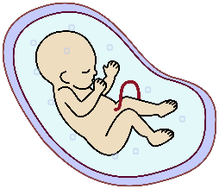
Researchers believe the fetus knows if it was wanted or not, if it is the gender preferred by the parents, and if maternal and paternal families are happy about the situation or not
A child tends to like the foods and beverages that the mother ate and drank during pregnancy
It’s not just maternal stress that can impact the
developing fetus. Studies with mice led by Tracy Bale, PhD, at the University of Maryland, School of Medicine, have shown that negative and/or chronic stressors can alter the father’s sperm, which then can alter fetal brain development
©Arlene R. Taylor PhD - www.ArleneTaylor.org

Slide 9

Epigenetics may also help to explain the “rage” or “depression” that some abandoned, foster, surrogate,
And adopted children exhibit. Their new environments
are very different from the gestational environment it became accustomed to. Healthy or unhealthy, it was familiar: smells, tastes, sounds, touch, music, and sometimes language, race, culture, or even location on the planet. This disconnection can be stressful, unsettling, and terrifying for the child. It can help if the adoptive parents have a piece of clothing from the biological mother containing her “smell” to help the child transition from one environment to another
©Arlene R. Taylor PhD - www.ArleneTaylor.org

Slide 10

Epigenetics may actually account for more than the estimated 70 percent since it can impact genetics
This relatively new body of knowledge about biology
helps to explain how some illnesses, diseases, addictions, and other behaviors tend to “run” in families, occurring more frequently than in other family systems
It is also clarifying what you can and cannot
change in this complex nature-nurture equation
©Arlene R. Taylor PhD - www.ArleneTaylor.org

Slide 11
Who you are as a unique individual involves complex interactions among your brain and spinal cord, your genome (genetic biological inheritance of chromosomes and genes), your epigenome (everything that is not genetics), your microbiome and virome (bacteria and viruses⎯good and bad⎯that live inside you),
Which means, as William Faulkner put it, the past is never dead. It’s not even past! You carry it within you.
Epigenetics includes Cellular Memory . . .
©Arlene R. Taylor PhD - www.ArleneTaylor.org

Slide 12
Cellular memory is a label for imprinted memories that are passed from biological ancestors to their offspring
It is fascinating phenomenon involving subconscious memories of behaviors exhibited by biological ancestors from 3-4 generations back⎯and that can be passed on to the next 3-4 generations of your biological line
These memories are thought to be carried on
protein strands in cells that have a nucleus⎯
and can provide an impetus or an urge toward
specific behaviors
©Arlene R. Taylor PhD - www.ArleneTaylor.org

Slide 13
You do not choose what was donated to you by your biological ancestors but you DO choose whether or not you will act upon the impulses
Cellular memory helps to explain how specific behavioral and disease patterns show up frequently in generational lines, albeit inconsistently; behavioral differences observed among siblings with the same parents and in foster, surrogate, and adopted children regardless of present environment; and in behavioral changes related to organ transplantation
©Arlene R. Taylor PhD - www.ArleneTaylor.org

Slide 14
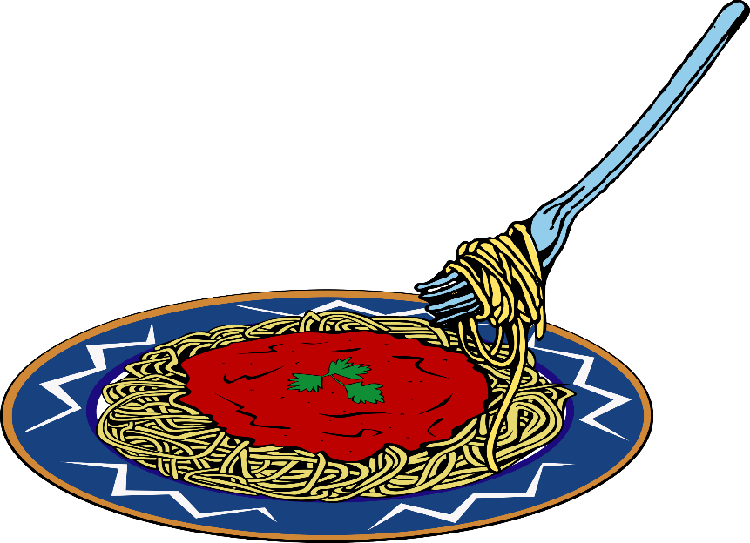
I was presenting the topic of Cellular Memory and a woman came up to me at the break and said,
“I need to tell you something at the next break⎯
right now I have to call my brother and tell him
he’s not crazy . . . ”
©Arlene R. Taylor PhD - www.ArleneTaylor.org

Slide 15
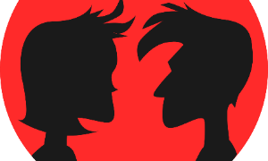
Cellular memory may impact relationships via likes
and dislikes whether or not you can verbalize reasons
You build and retain cellular memory for every person with whom you have sexual activity—which can impact potential monogamy and cause problems in new relationships when
traumatic cellular memory exists from prior relationships
Cellular memory is more readily activated in situations that
resemble the one in which the original cellular memory was
laid down (visit ancestral countries, home for holidays,
study for a test under an influence of a drug) and is likely
Involved with déjà vu or past-life theory
©Arlene R. Taylor PhD - www.ArleneTaylor.org

Slide 16
You are an omnibus in which your ancestors ride
―Oliver Wendell Holmes
Once two systems come into energetic contact, they are forever connected by the cellular memories of their connection
Experiences with parents and others close to you remain within you ―Paul Pearsall PhD
Make sure those experiences are pleasant, loving, and affirming…
©Arlene R. Taylor PhD - www.ArleneTaylor.org

Slide 17
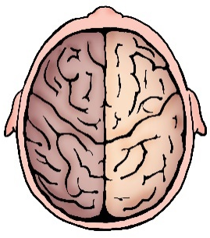
Fourteen epigenetic strategies have been identified over which you can have partial⎯if not complete⎯control:
Mindset
Self-talk
Emotional Intelligence
Physical Exercise
Brain Stimulation
Optimum Sleep
Essential Hydration
Safety
Sunlight
Nutrition
Laughter
Support System
Stress Management
Life Satisfaction
How can you impact epigenetics positively?
©Arlene R. Taylor PhD - www.ArleneTaylor.org

Slide 18
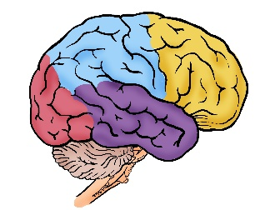
Learn what you can about your genetic inheritance, as strategies may be available to reduce your risk for some illnesses and diseases
Create a brain-based longevity lifestyle and
implement the 14 researched components
Identify your mindset and personal perceptions and course correct as needed
Prevent what has been shown to be preventable
©Arlene R. Taylor PhD - www.ArleneTaylor.org

Slide 19

Raise your Emotional Intelligence or EQ to help avoid conflict, reduce stress, and make good choices
Choose wisely, making decisions based on informed evaluations
Use willpower to help you create and sustain new behaviors successfully
Give thanks and enjoy life, taking the best
care possible of the brain and body leased
to you for use on Planet Earth
©Arlene R. Taylor PhD - www.ArleneTaylor.org
©Arlene R. Taylor PhD - www.ArleneTaylor.org

Slide 20

To recap: you arrived on Planet Earth with a
genetic biological inheritance⎯your genome⎯
responsible for about 30 percent of your level
of wellness and your potential lifespan
Your epigenome is everything that is not genetics and is worth 70 percent of how well and how long you live
Epigenetics (lifestyle) has a much greater impact on health and longevity than was thought possible; the choices you make via epigenetics impact you negatively or positively
©Arlene R. Taylor PhD - www.ArleneTaylor.org

Slide 21
I pray that you may prosper in all things and be in good health, even as your soul prospers
⎯Apostle Paul, 3 John 1:2
Do you really want to stay healthier and younger for longer?
You can’t change the past, but you can create
a healthier future!
You are the only person who can do this for you
©Arlene R. Taylor PhD - www.ArleneTaylor.org

